Slide 1
CASAS Reports: Assess, Analyze and Adjust
Presented by
Debbie Jensen
Baldwin Park Adult and Community Education

Slide 2
Introduction
CASAS is a way of life.
We can use it to guide our efforts to Assess our students, Analyze what they know and don’t know, and Adjust our teaching.
Before you leave:
1. Introduce the reports.
2. Show you my favorites.
3. Use the Performance Report
Assess what the students don’t know
Analyze what changes should be made
Adjust teaching to reflect what the students need to learn.
4. Practice together.
Notes:
How presentation will benefit audience: Adult learners are more interested in a subject if they know how or why it is important to them.
Presenter’s level of expertise in the subject: Briefly state your credentials in this area, or explain why participants should listen to you.

Slide 3
Scores,NRS,EFLs,Grade

Slide 4
Types of Reports
Next-Assigned Test
Personal Score Report (on computer at test site)
Skills Profile
Individual Skills Profile
Competency Performance*
Student Performance
Class Performance
Agency Performance
Test History—Student Test Summary
Notes:
Lesson descriptions should be brief.

Slide 5
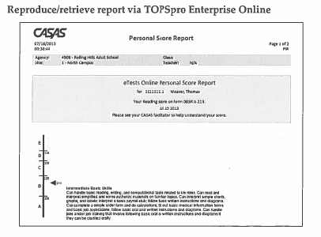
Final Message at the Testing Center
Notes:
Example objectives
At the end of this lesson, you will be able to:
Save files to the team Web server.
Move files to different locations on the team Web server.
Share files on the team Web server.

Slide 6
Next Assigned Test

Slide 7
Individual Skills Profile

Slide 8
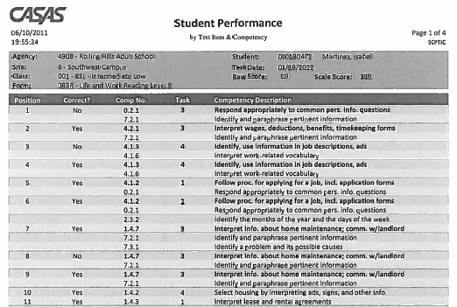
Student Performance

Slide 9
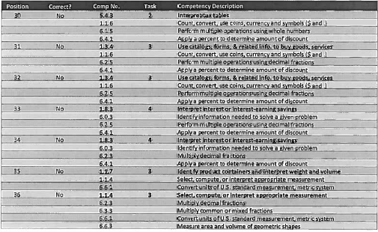
What are they struggling with?

Slide 10
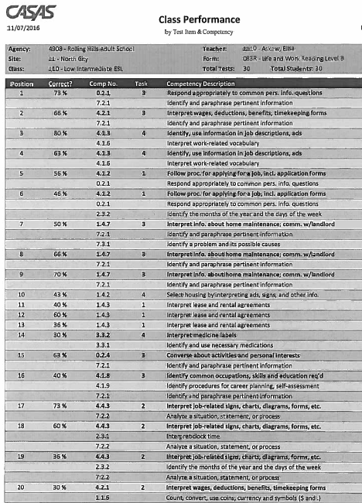
Class Performance
56%
46%
50%
43%
40%
36%
30%
40%
36%
30%

Slide 11
My Math Class

Slide 12
Agency Performance
When might you use this report?

Slide 13
Student Test Summary

Slide 14
What’s Next?
Check your textbooks for these competencies.
Use Table of Contents for quick assignments.
Other Ideas?

Slide 15
Assessment and Evaluation
Prepare a quiz or challenge to assess how much information participants learned.
Survey participants to see if they found the training beneficial.

